Slide 1

Store Sales Analysis Dashboard
Power BI Dashboard Project
Tools Used:
Power BI
Power Query
DAX
Excel

Slide 2
Project objective
Objectives
Analyse overall store sales performance.
Identify top-performing product categories.
Understand customer purchasing behavior.
Compare monthly sales trends.
Build an interactive dashboard for business decision-making.

Slide 3
Dataset overview
Dataset Information
1,000 Customers
Transaction Data
Product Categories
Age Groups
Gender
Monthly Sales
Quantity Sold
Price per Unit
Total Amount
KPIs Created
Total Revenue
Total Orders
Total Quantity Sold
Average Order Value
Average Price per Unit
Unique Customers

Slide 4
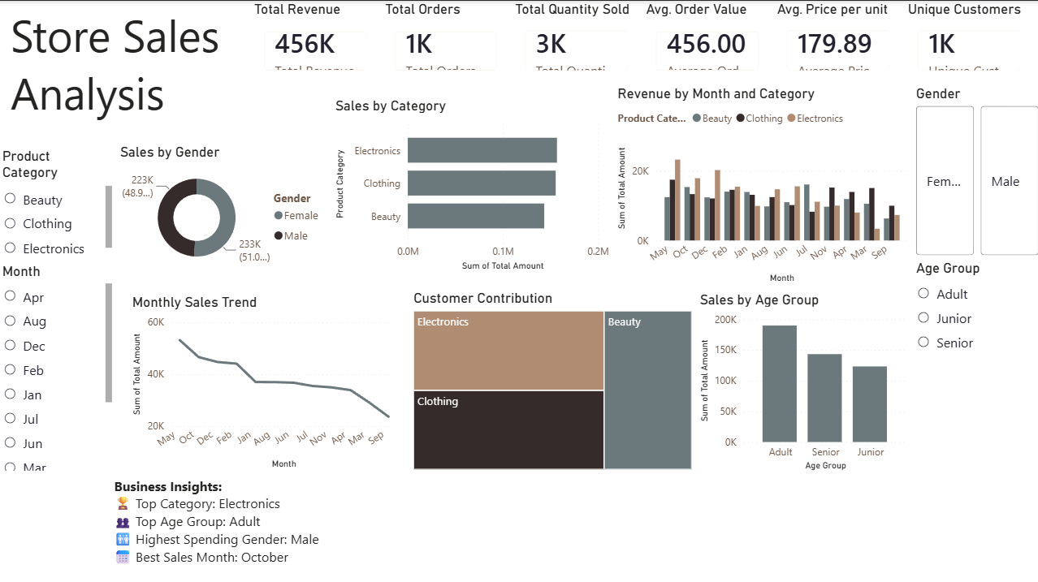
Dashboard preview
Dashboard Features
KPI Cards
Interactive Slicers
Monthly Sales Trend
Sales by Category
Revenue by Month & Category
Customer Contribution
Sales by Age Group
Gender Analysis
Business Insights

Slide 5
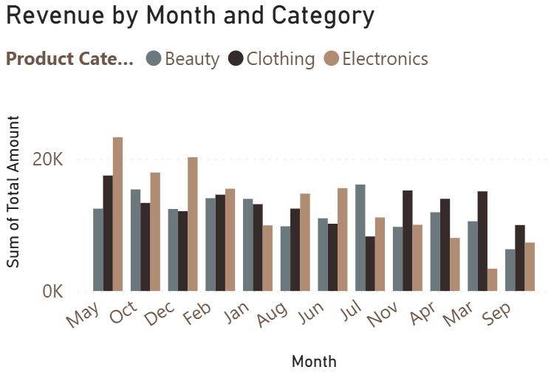
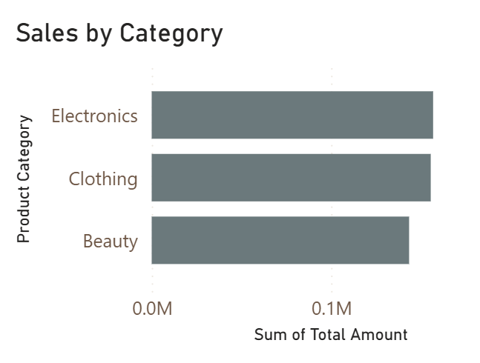
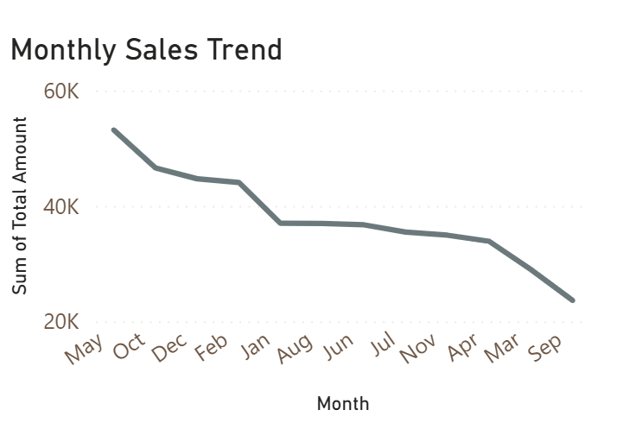
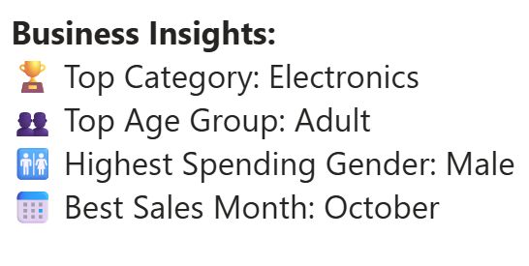
Key insights
Insights
Electronics generated the highest revenue.
Adult customers contributed the highest sales.
Male customers spent slightly more than female customers.
October recorded the highest sales.
Sales performance varied across different months.

Slide 6
Business recommendations
Recommendations
Increase inventory for Electronics products.
Launch marketing campaigns targeting Adult customers.
Prepare promotional offers before October.
Improve sales of lower-performing categories.
Use dashboard filters to monitor sales performance regularly.

Slide 7


Skills demonstrated
Technical Skills
Power BI
Power Query
DAX
Data Cleaning
Data Modelling
Data Visualization
KPI Design
Interactive Dashboard Design
Business Analysis
Deliverables
Interactive Power BI Dashboard
GitHub Repository
PowerPoint Presentation

